Slide 1

Lesson: 3.04 Debugging and Scope
Microsoft Philanthropies TEALS Program
Introduction to Computer Science
Semester 2

Slide 2
Debugging and Scope
After this lesson, you will be able to...
Define and identify scope, aliasing, stack diagram, stack trace
Demonstrate that changing a list inside a function updates the list outside of the function
Demonstrate that updating variables in a function does not affect the variable outside of the function
Demonstrate the use of global variables
Draw a simple stack diagram

Slide 3
Plan
Do Now
Lesson
Lab/Review
Debrief
Notes:
5 Minutes - Do Now
10 Minutes - Lesson
30 Minutes - Lab/Review
10 Minutes - Debrief

Slide 4
Do Now, Part 1
In your notebook, write down one thing you learned in the previous class.
Rank the following from easiest to hardest:
A. Importing built-in functions
B. Using randint
C. Abstraction/creating functions
D. Passing int/str/float/bool arguments into functions
E. Calling a function
F. List syntax
G. Return vs print
3. Type the following into the console:
my_list = ['a', 'b', 'c', 'd']
# input: a list of strings
# output: None
def my_function(list_argument):
list_argument[0] = 'z'
print("Inside function:", my_list)
print("Before function:", my_list)
my_function(my_list)
print("After function:", my_list)
Notes:
We will have a quiz next class covering all of the above topics. Is there any topic you would like to focus on and cover more of?
Ask the students the following:
What happened when you ran this program? Try writing a similar program but passing in integers instead of a list. What happens?

Slide 5
Do Now, Part 2
In your notebook, predict the output of the following program:
def double_print(input_string):
for i in range(2):
print(input_string)
def double_concat(part1, part2):
concat = part1 + ", " + part2
double_print(concat)
str1 = "Hello"
str2 = "world"
double_concat(str1, str2 + "!")
We will see a stack diagram for this example code, later in this lesson.
Notes:
Ask students:
What does the double_print() function do for whatever input it receives? (summarize in a few words) What does the double_concat() function do for the two inputs that it receives?

Slide 6
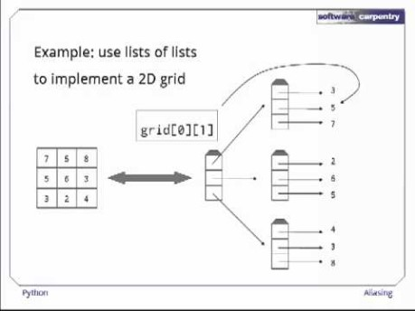
Aliasing
Aliasing – Data in memory that has multiple variables associated with it.
Notes:
Video direct link -https://youtu.be/7m_cw30tyr0
Video attribution - https://software-carpentry.org/

Slide 7
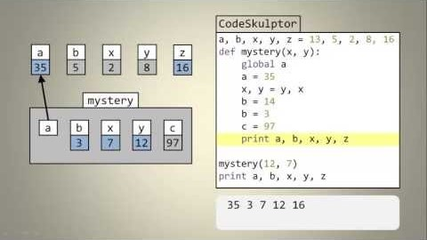
Variable Scope
Scope of functions - variable scope is the part of a program where a variable is accessible.
Global Variable –
A variable which is defined in the main body of a file is called a global variable.
Global variables are defined outside of a function and used in many different functions.
Global variables are often used for constants.
NOTE: We use the 'ALL_CAPS' convention for global variables.
Notes:
Video Direct Link
https://www.youtube.com/watch?v=A054Ged9suI-

Slide 8
Lesson (continued)
Local Variables
Variables available inside functions include the function parameters, the variables defined in the function, and variables declared as global.
Local variables of functions can't be accessed from outside code when the function call has finished.
Debugging
Print statements throughout your code can let you know where in the program things are not operating as expected.
Notes:
Demonstrate how to draw the Stack Diagrams shown in the course book (found in section 3.4) and explain how they show the scope of variables as they related to functions.
Point out the error messages that will occur if you use a variable out of its scope.

Slide 9
Discussion - Conventions
Discuss that programming languages frequently have conventions. For instance:
camelCase for function names
ALL_CAPS for globals used as constants
underscore_separated for local variables
These conventions help make code more readable, but they aren't essential to functionality (in most cases).

Slide 10
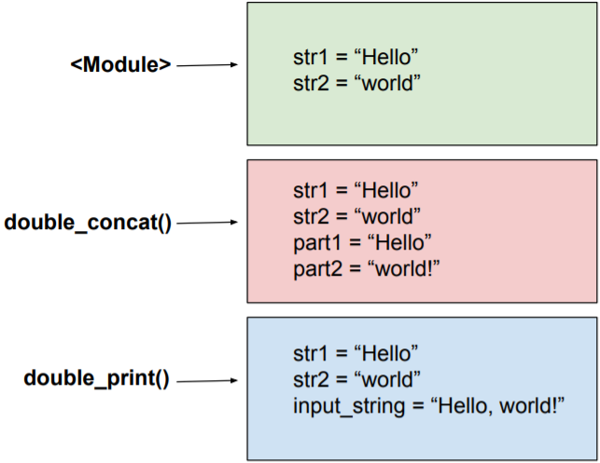
Stack Diagrams
A stack diagram shows the scope of variables as they relate to functions.
You will receive an error message if you use a variable out of its scope.
This example stack diagram shows defined variables and their values for the program from Do Now, Part 2.
Notes:
Notice for example that in the double_concat() function, str2 keeps its global definition of "world", but part2's definition is "world!"
Also notice that the global values str1 and str2 are available everywhere, but the part1 and part2 definitions created in the double_concat() function are not available in the double_print() function.

Slide 11
Stack Traces
Stack traces are related to stack diagrams.
If you try to access a variable outside of its scope, Python will print a traceback error message, which can help you determine why the error occurred.
For example, if you try to print the "part2" variable inside the double_print() function in the example above, this error message will be printed:
Traceback (most recent call last):
File "main.py", line 15, in <module>: double_concat(str1, str2 + "!")
File "main.py", line 12, in double_concat: double_print(concat)
File "main.py", line 8, in double_print: print(part2)
NameError: name 'part2' is not defined
The innermost, lowest-level function will be listed last. This is where the actual error occurred. The lines above that show exactly where the call to that function originated.
Notes:
Notice for example that in the double_concat() function, str2 keeps its global definition of "world", but part2's definition is "world!"
Also notice that the global values str1 and str2 are available everywhere, but the part1 and part2 definitions created in the double_concat() function are not available in the double_print() function.

Slide 12
Lab Part 1 - Aliasing
a = [1, 2, 4]
b = a
Will updating b affect a? Explain why or why not.
# input: a list of ints
# output: an int
def update_list(a_list):
a_list[3] = "yo"
b = a_list[4]
b = 100
my_list = [1, 2, 3, 4, 5]
update_list(my_list)
print(my_list)
Predict what the my_list list will print out when this code is run. If you are not sure, test the code by copying and running it.

Slide 13
Lab Part 2 - Scope
Draw a stack diagram for the following:
var_1 = "kittens"
var_2 = "cookies"
# Input: a string
# Output: a string
def my_function(my_favorite_things):
song_lyrics = "raindrops on roses, "
combined_song = song_lyrics + my_favorite_things
return combined_song
# Input: a string
# Output: a string
def my_function_2(item, item2):
full_lyrics = item + " on " + item2
full_song = my_function(full_lyrics)
return full_song
my_song = my_function_2(var_1, var_2)
Notes:
var_1 = "kittens"
var_2 = "cookies"
# input: a string
# output: a string
def my_function(my_favorite_things):
song_lyrics = "rain drops on roses,"
combined_song = song_lyrics + my_favorite_things
return combined_song
# input: a string
# output: a string
def my_function_2(item, item2):
full_lyrics = item + "on " + item2
full_song = my_function(full_lyrics)
return full_song
my_song = my_function_2(var_1, var_2)

Slide 14
Lab Part 2 - Practice 1
Write down what (if anything) is wrong with the following code.
If there is an issue, write out how to fix it.
var_1 = 'cat'
var_2 = 'dog'
def print_out_my_favorite(favorite_pet):
if favorite_pet == var_1:
print("My favorite pet is the cat.")
if favorite_pet == var_2:
print("My favorite pet is the dog.")
var_1 = "dog"
var_2 = "cat"
print_out_my_favorite(var_1)
print("var_1:" + var_1 + " var_2:" + var_2)

Slide 15
Lab Part 2 - Practice 2
Write down what (if anything) is wrong with the following code.
If there is an issue, write out how to fix it.
var_1 = 'cat'
var_2 = 'dog'
def print_out_my_favorite(favorite_pet):
var_1 = 'dog'
var_2 = 'cat'
if favorite_pet == var_1:
print("My favorite pet is the cat.")
if favorite_pet == var_2:
print("My favorite pet is the dog.")
print_out_my_favorite(var_1)
print("var_1:" + var_1 + " var_2:" + var_2)

Slide 16
Lab Part 2 - Practice 3
Write down what (if anything) is wrong with the following code.
If there is an issue, write out how to fix it.
var_1 = 'cat'
var_2 = 'dog'
def print_out_my_favorite(favorite_pet):
if favorite_pet == var_1:
print("My favorite pet is the cat.")
if favorite_pet == var_2:
print("My favorite pet is the dog.")
print_out_my_favorite(var_1)
print("var_1:" + var_1 + " var_2:" + var_2)

Slide 17
Lab Part 3 - On Your Own
Write a program that has a global variable, my_num.
Create three functions that update my_num:
add2: this function adds 2 to my_num
multiply_num: this function takes in a parameter, multiplier, and multiplies my_num by that parameter
add2_and_multiply: this function takes in a parameter, multiplier, calls add2, then calls multiply_num.
Complete the program by writing code in the main part of the program that:
sets my_num to some initial value you choose
prints my_num
calls add2_and_multiply() with some argument you choose
prints the final value of my_num
Confirm that the printed values match what you expected.

Slide 18
Exit Ticket/Debrief
Concepts covered today: scope, aliasing, and stack traces.
In your notebook, write down two things that you learned today.
Notes:
Call a few students to the board to draw their stack traces from the lab and talk through them.

